Slide 1
CSE718
Nishat Nayla
ID: 23366022

Slide 2
TOC
Introduction
Agent-Based Simulations in Healthcare
DSMLs (Domain-Specific Modelling Languages)
Case Studies and Applications
Evaluation and Validation
Expected Contributions
Current Status and Next Steps
Conclusion

Slide 3

Introduction
Objective: Investigate operational interventions in healthcare like ward layouts, staff allocations using Agent-Based Modelling (ABM).
Challenge: Low acceptance of ABM in healthcare due to complexity and inaccessibility.

Slide 4
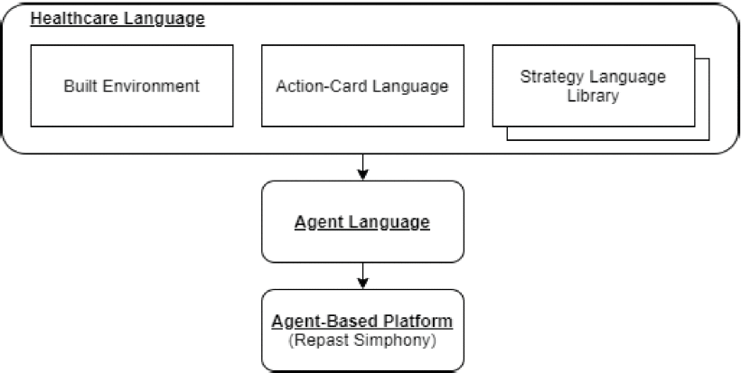
Agent-Based Simulations in Healthcare
Advantages: Captures complex emergent behaviour, suitable for diverse healthcare systems.
Techniques Compared: ABM vs. discrete event and monte carlo simulations.

Slide 5
DSMLs (Domain-Specific Modelling Languages)
02
Develop high-level DSMLs for healthcare professionals.
Facilitate participatory modelling with intuitive notations and automated translations.
Tools Used: JetBrains MPS for developing DSLs.

Slide 6
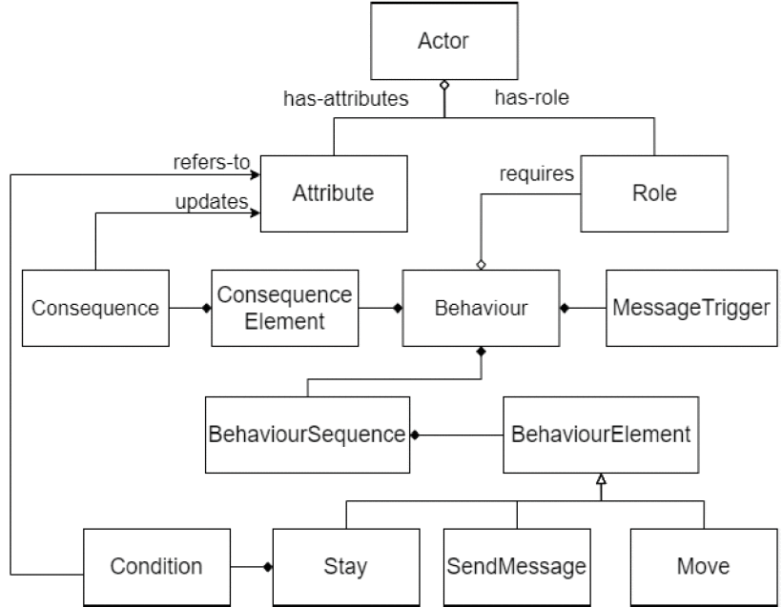

Slide 7
Case Studies and Applications
Example: COVID-19 testing schemes in Emergency Departments.
Aim: Test 'what-if' scenarios in hospital operations and infectious disease risks.

Slide 8
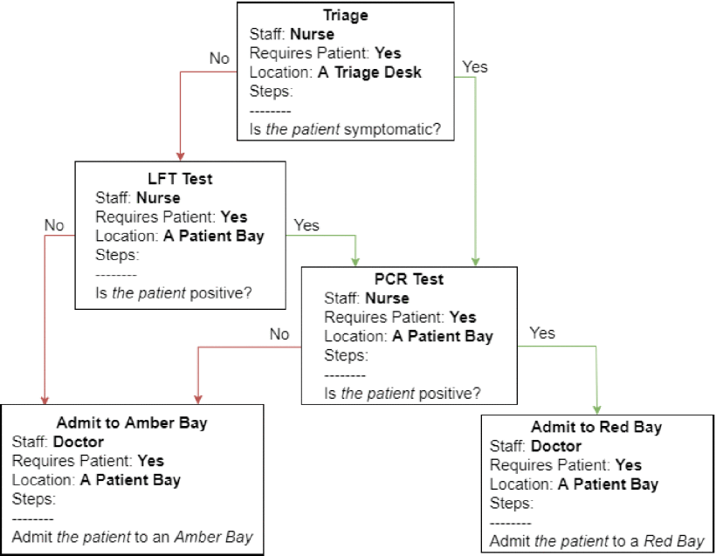

Slide 9
Evaluation and Validation
Collaboration: St. Thomas Hospital, London.
Focus: Understandability of simulations, clinical utility, and stakeholder engagement.

Slide 10
Project objective
Expected Contributions
Main Contribution: A family of DSMLs for healthcare professionals.
Research Contribution: Assess impact on model trust and development efficiency.

Slide 11
Current Status and Next Steps

Slide 12
Progress: Initial case study on COVID-19 testing efficacy.
Future Plans: Implement Action-Card Language, engage in new case studies.

Slide 13
DSMLs effectively bridge the gap between healthcare professionals and ABM technology.
Successful initial case studies demonstrate potential in healthcare settings.
Improved stakeholder engagement and understanding of simulation processes.
Conclusion

Slide 14
Future Work:
Further development and refinement of the Action-Card Language.
Expansion of case studies to different hospital departments.
Continuous evaluation of DSMLs' impact on simulation trust and efficiency.
Exploration of new DSMLs for broader healthcare system applications.

Slide 15
Impact:
Anticipated improvement in hospital operational decision-making.
Enhanced accessibility of ABM for non-technical healthcare stakeholders.
Potential for wider adoption of ABM in healthcare.

Slide 16
Thank you.

Slide 17
Reference:
"Department of Health The NHS Plan: a plan for investment a plan for reform", Department of Health, 2000.
Show in Context Google Scholar
F.Zhou, T. Yu, R. Du, G. Fan, Y. Liu, Z. Liu, J. Xiang, Y. Wang, B. Song, X. Gu et al., "Clinical course and risk factors for mortality of adult inpatients with covid-19 in wuhan china: a retrospective cohort study", The Lancet, vol. 395, no. 10229, pp. 1054-1062, 2020.
Show in Context CrossRef Google Scholar
A. Voinov and F. Bousquet, "Modelling with stakeholders", Environmental Modelling & Software, vol. 25, no. 11, pp. 1268-1281, 2010.
Show in Context CrossRef Google Scholar
J. Rumbaugh, I. Jacobson and G. Booch, "The Unified Modeling Language Reference Manual", Pearson Higher Education, 2004.
Show in Context Google Scholar

